Slide 1

LeeBay Presentation (IOD Capstone Project)

Slide 2
Project Definition - Leebay
Create an EBay – like website where users can create their own live auctions and others can bid and eventually purchase the items
Features
Users can create an account
Users can create live auction with a set end date
Auctions can include a title, description, image, bid price & location
A comments section on each auction allows the bidders to ask questions directly to the seller
Users can bid on any currently live auctions
Seller contact details are provided to the buyer after winning the auction to carry out the transaction (The transaction itself is not integrated)

Slide 3
Project Definition - Leebay
Create an EBay – like website where users can create their own live auctions and others can bid and eventually purchase the items
Stakeholders
Me (Developer, owner)
Buyers
Sellers
Potential advertisers
Potential investors
Assumptions
Users are happy to carry out transaction themselves (Payments / postage not integrated )
One auction photo is enough
No buy now option is ok
Auction comments can be deleted after auction ends
Auction items will be legal to sell

Slide 4
Project Design Steps
Design stages
Clearly define the purpose (Functionality & Stakeholders)
Research how other websites have addressed these requirements
Create Gantt chart to outline the project schedule across 9 days
Create low-fi drawings on paper
Decide which technology is best suited to meet the project requirements
Create a Hi-fi mock up on Figma
Break Figma UI into React components
Design Database with excel / spreadsheet
Define routes for backend (Later put into swagger doc)
Identify backend potential security concerns and how best to address them

Slide 5
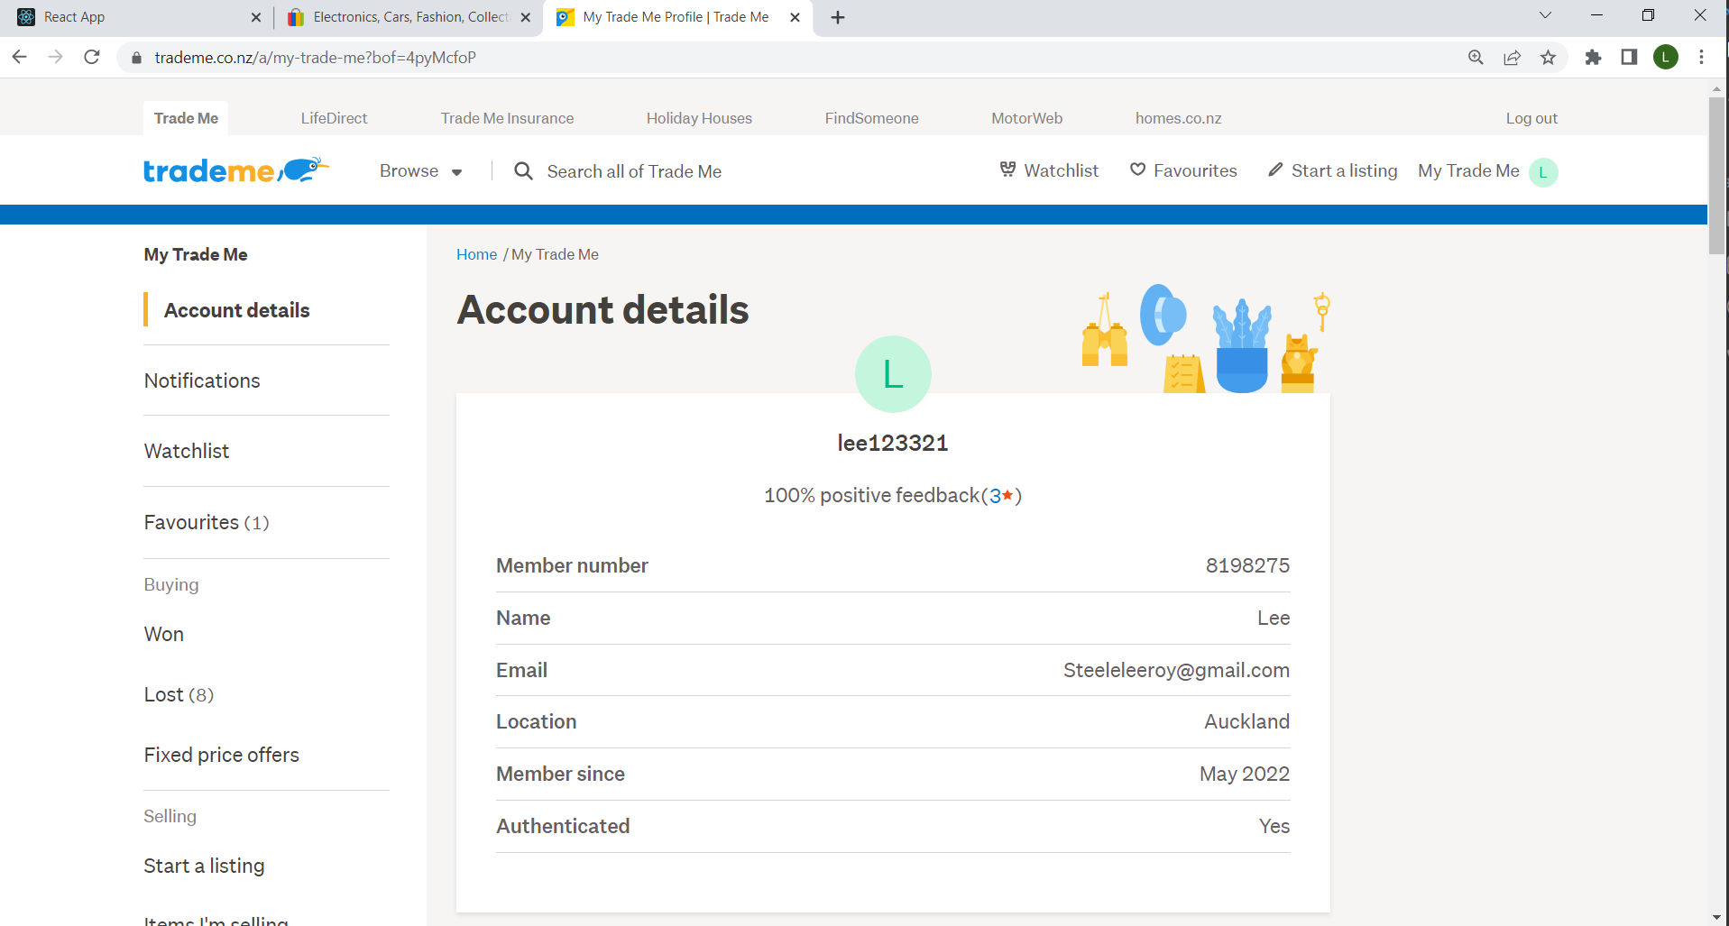
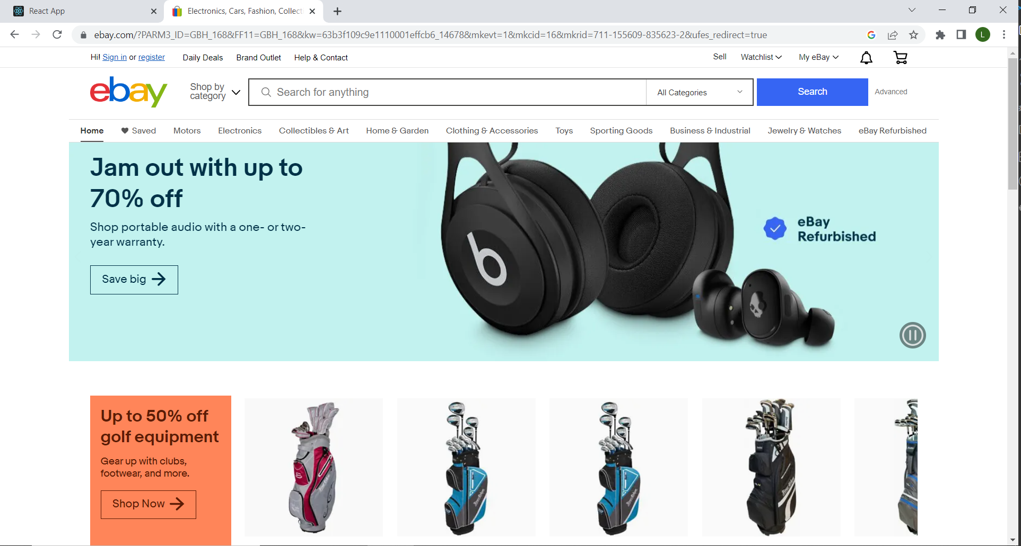
Project Research

Slide 6
Project Outline

Slide 7
Project Technology
Front end
ReactJS – Front End UI
Material UI – For UI Templates & Components
Axios – For HTTP requests between the Front End <–> Backend
Moment – For handling date related data
Back end
MySQL – Relational database requirement
NodeJS / ExpressJS – Backend environment
Nodemon – Run backend during development
Multer – Backend dependency, for uploading / deleting images
Swagger – For backend documentation
body-parser – For accessing http body data
Database
MySQL – Relational database requirement
Local Folder storage for images
Design
Figma – Front end
MS Excel – Database planning

Slide 8
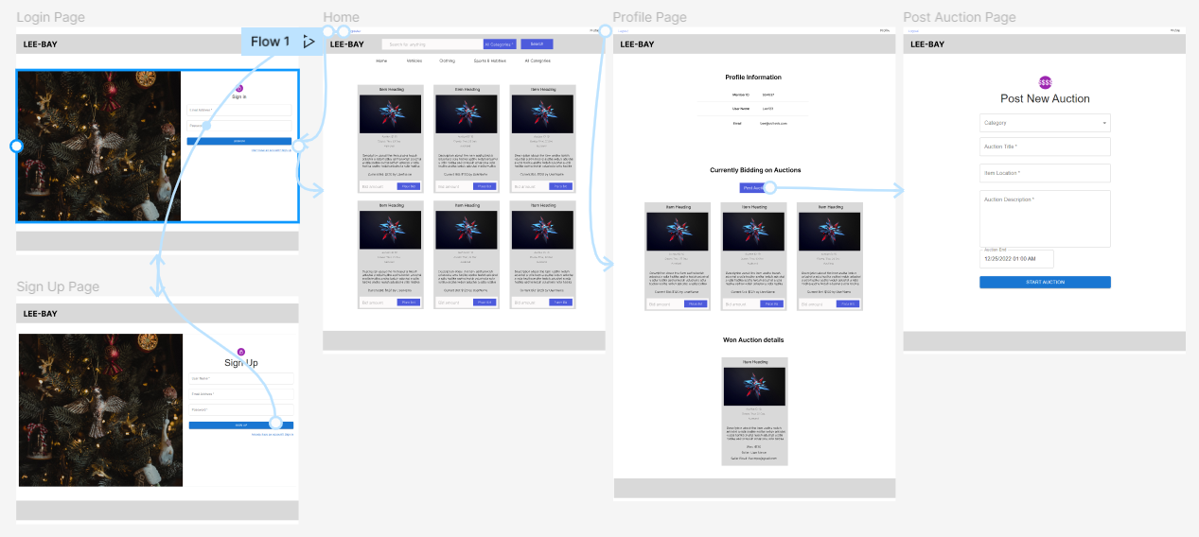
Figma Design

Slide 9





Leebay
ARCHITECTURE DIAGRAM
Database / MySQL
User / Browser
Front End / React JS
Backend / NodeJS
DB: "leebay“ / Port 3306
Local folder / Image storage
localhost:3000
localhost:4000
capstone_react_frontend\public\images

Slide 10
Database structure (MySQL)
Table 1
Users Table (Login details)
User ID | User Name | Email | Password
(Primary Key)
int NOT NULL AUTO INCREMENT PRIMARY KEY | varchar(50) not null | varchar(50) not null | varchar(50) not null
Table 2
Current Auction Items
Auction ID | Seller User ID | Highest Bidder ID | Category | Image Path | Auction Title | Location | Description | Current Price | End Date
(Primary Key) | (Foreign Key) | (Foreign Key)
int not null AUTO INCREMENT | int not null | int not null | varchar(255) not null | varchar(255) | varchar(255) not null | varchar(255) not null | varchar(255) | int not null | datetime

Slide 11
Database structure (MySQL)
Table 3
Closed Auction Items (Taken from current auction items when end date is reached)
Auction ID | Seller User ID | Highest Bidder ID | Category | Image Path | Auction Title | Location | Description | Sold Price | End Date | Seller User Name | Seller Email
(Primary Key) | (Foreign Key) | (Foreign Key)
int not null | int not null | int not null | varchar(255) not null | varchar(255) not null | varchar(255) not null | varchar(255) not null | varchar(255) not null | int not null | datetime | varchar(50) not null | varchar(50) not null
Table 4
Auction Comments (Cascade delete when auction is deleted)
Comment ID | User ID | Auction ID | Comment_text
(Primary Key) | (Foreign Key) | (Foreign Key)
int not null AUTO INCREMENT | int not null | int not null | varchar(255) not null

Slide 12
Backend Documentation – Swagger demo

Slide 13
Security Concerns
Currently there is no encryption on sensitive data and requests are made via http not https. This means hackers can easily get access to sensitive data and manipulate the database
I intend to address this before making the website live to the public via AWS

Slide 14
Project References
GitHub links
Front End – https://github.com/Leeroy-Steele/Leebay---Capstone-React-Front-End.git
Backend - https://github.com/Leeroy-Steele/Leebay-Capstone-Nodejs-Back-End-.git

Slide 15
Live Demo

